Slide 1


Purchase Order Process Flow- Odoo ERP

Slide 2
Overview
The solution implemented seeks to provide PO approval process through the ERP system. This is further enhanced by the automatic email alerts sent to approvers once the PO is created. Once implemented, this will help improve efficiency and reduce the duration taken to get final approval due to communication delays

Slide 3
Creation of RFQ
Once a purchase requisition has been approved, a Request for Quotation is created to enquire the best price rates in the market for the product requested. Click Purchases module > Request for quotation > Create

Slide 4
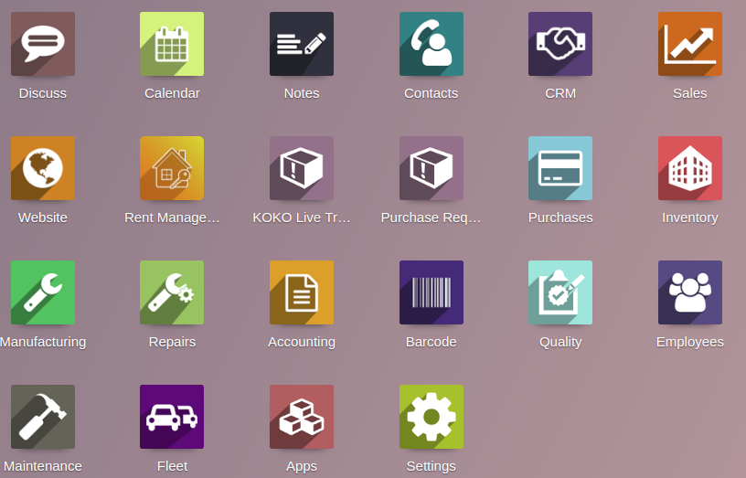

Slide 5
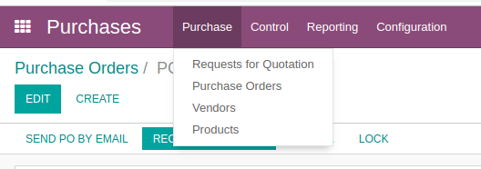
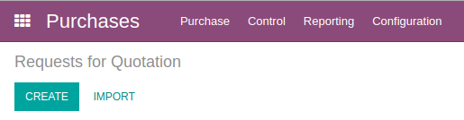

Slide 6
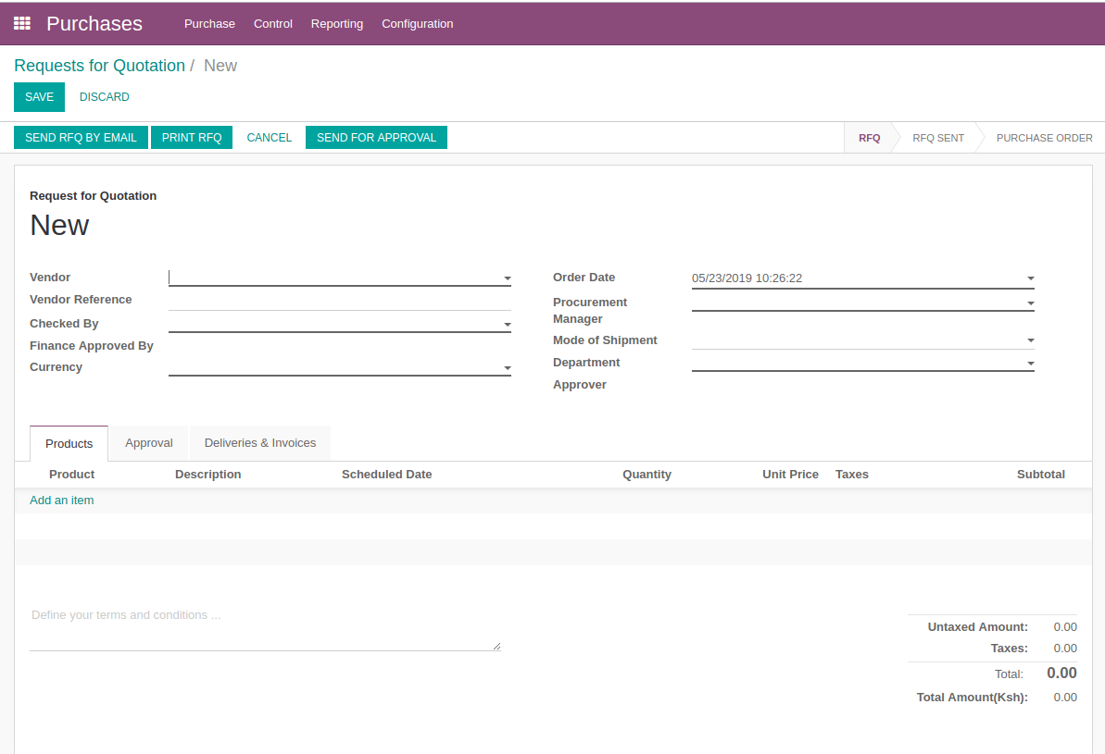

Slide 7
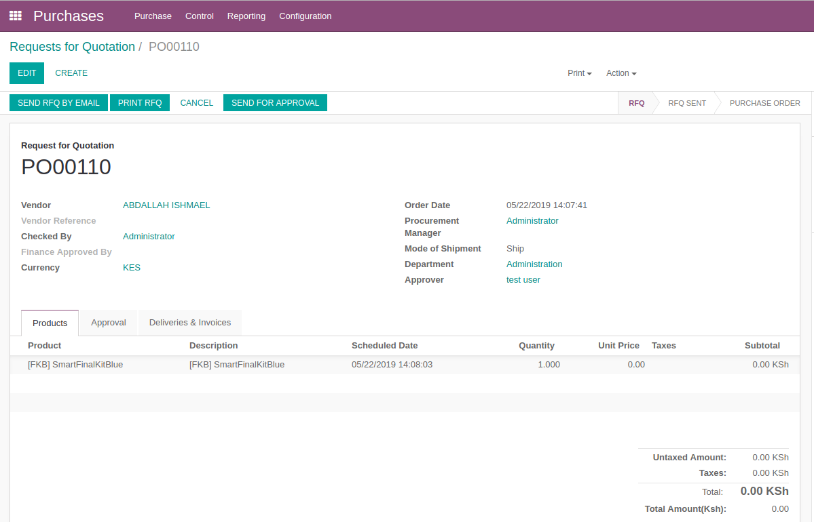

Slide 8
The request for quotation will be sent out to different suppliers who will respond with their respective price quotations. Once this is done, the procurement department will select the appropriate suppliers based on the selection criteria and create a PO to procure the item

Slide 9
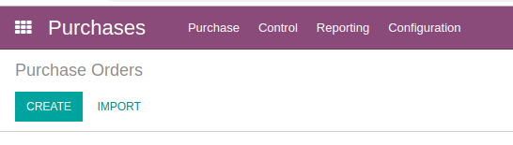
Creation of Purchase Order

Slide 10
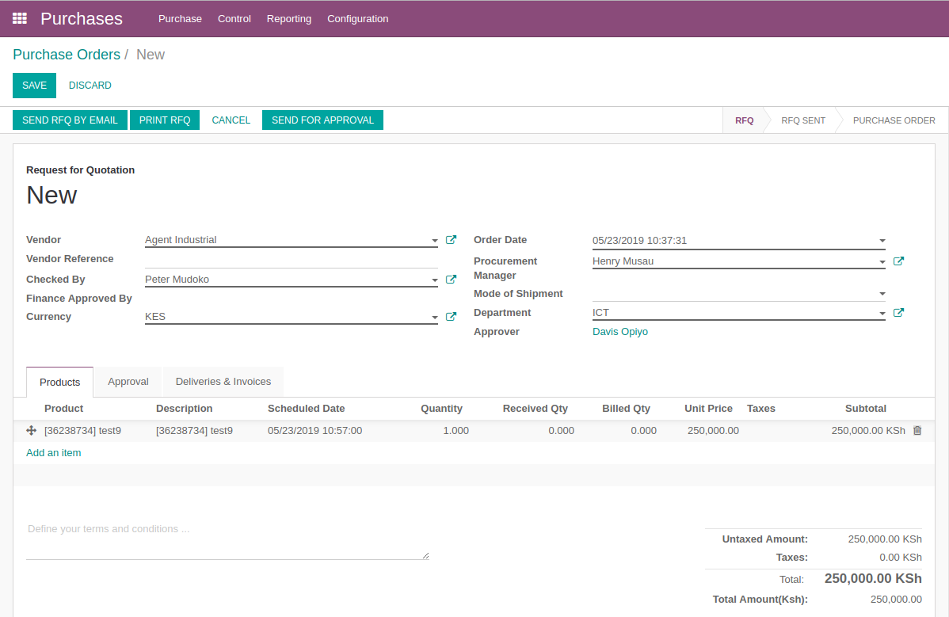

Slide 11
PO Approval Criteria
The purchase orders will be approved from the odoo system. The approvers shall be the item requestor(Checked by), Purchase Manager, Head of Department and final approval from the Finance department.
Upon creation of the PO, a notification will be sent to the requestor to start the approval cycle. Once he/she approves, a notification mail will be triggered to the second approver to approve, then to the third approver and finally to the finance approver.

Slide 12
Once all details are entered in the PO, click ‘send for Approval’ button

Slide 13
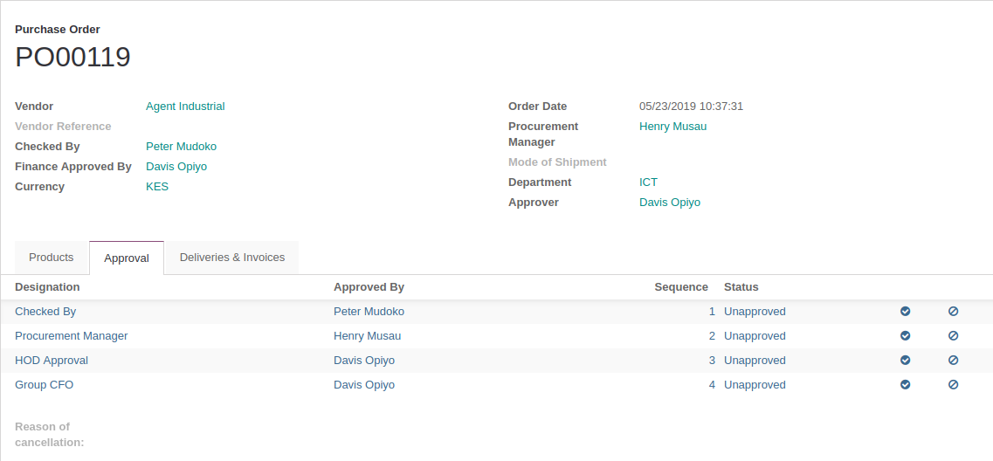
Once the ‘Approve for button’ is clicked the approval sequence will auto-populate in the ‘approval’ tab of the PO form.

Slide 14
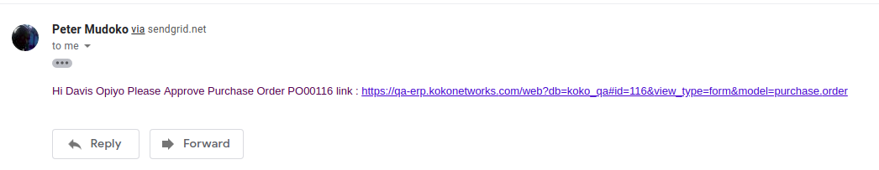
Notification email triggered to the first approver

Slide 15
The approver has the option of approving or rejecting the PO using the buttons at the extreme right.

Slide 16
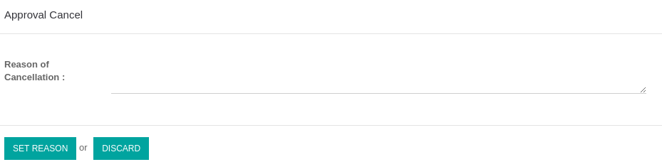
Approval Logic
The approval must follow the set sequence (1,2,3,4) i.e The approver in sequence 2 cannot approve before the person in sequence 1 approves.
If the PO is rejected, dialogue box to state the reason for rejection will appear
The Approvers digital signatures will be pre-loaded into Odoo, this will appear in the final PO document once the approval is fully done. If only 2 people approve, the only their signature will populate.
A rejected PO will be set back to draft state to make necessary correction for re-approval or will totally be cancelled

Slide 17
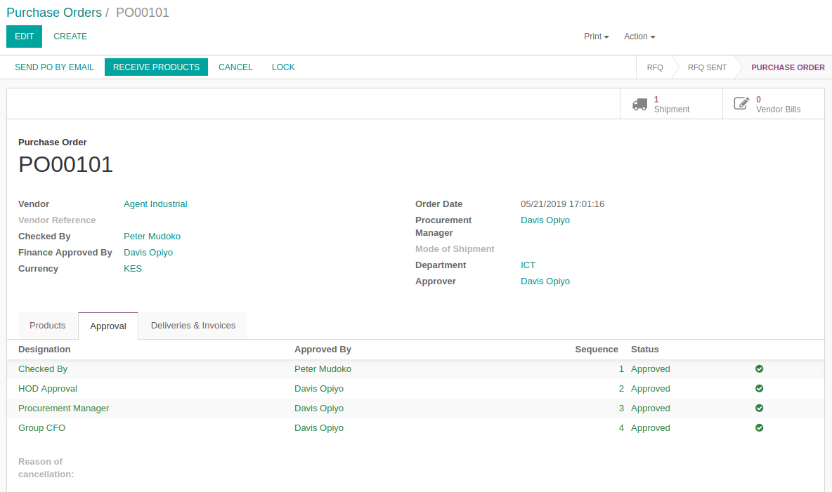
A Fully Approved PO

Slide 18
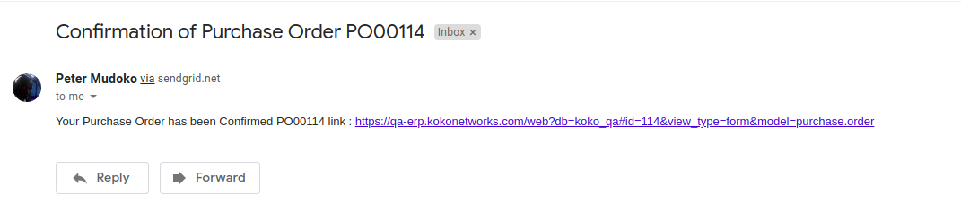
Once all the approval are done, the Purchase manager will receive a confirmation email of the approval, print the PO and send to the supplier a fully signed Purchase Order

Slide 19
